Slide 1

WEB DEVELOPER ROADMAP
Aldion Amirrul

Slide 2
Our Agenda
Intermezo
Frontend Developer
Backend Developer
Rockstar Fullstack Developer
Conclusion

Slide 3





Aldion Amirrul Endryanto
Backend Developer & Hardware Engineer
& Cat lover
Informatic Engineering Student at UNTAG from 2016 - 2020
Committee at Surabaya.py from 2020 – Now
Backend Developer at Nusanet Surabaya from 2019 - 2021
Software Engineer at Avian Brands from 2021 - Now

Slide 4
What is a Web Developer ?
A web developer is someone who takes a web design - which has been created by either a client or a design team - and turns it into a website application.
Note : He’s not a wizard or PC Repairman !

Slide 5
Website Application ?
*Website Application
}
Browser
}
FrontEnd
WorldEnd
FullStack
request
response
}
Server
BackEnd

Slide 6
FrontEnd - BackEnd - FullStack

Slide 7
FrontEnd
HTML
Javascript
CSS
GIT
JS Framework (Angular, Vue, React?)
Build Tools (npm, bower, webpack)
Deal with User Interfaces
Form & Input Validation
BackEnd Communication Channels
Sometimes u might Deal with UX Strategies

Slide 8
FrontEnd
Server-side Bussiness Process (Auth, Controller Logic, etc.)
Server Configuration
Database Configuration, Management, & Operation

Slide 9
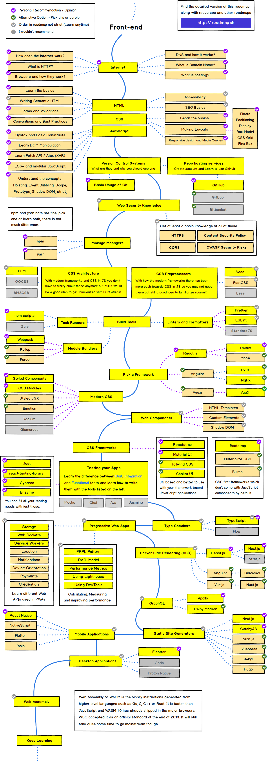
FrontEnd Developer Roadmap

Slide 10
BackEnd
Server-side language like PHP, Python, Node, Go, etc.
Some Frameworks like Laravel, Django, Express
Database Query & Configuration
Web Servers configuration
At least, u must know basic about HTML
Javascript, and CSS.
Server-side Bussiness process (Auth, Functions, etc.)
Data validation
Data Storage & Data Access
Scheduled Proccess
API

Slide 11
BackEnd
Complex UI Design
Client-side Validation
And other mthrfckr FrontEnd Stuff

Slide 12
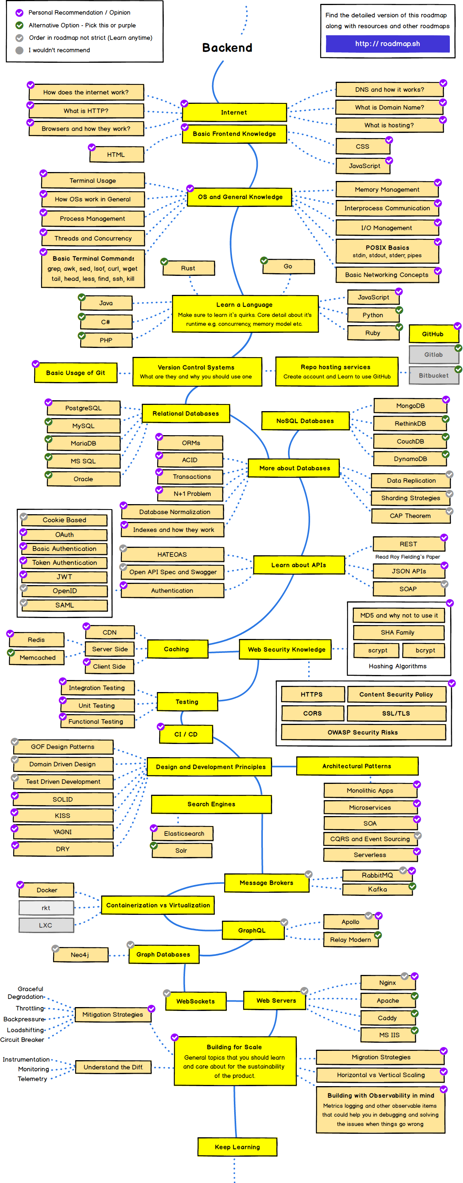
BackEnd Developer Roadmap

Slide 13
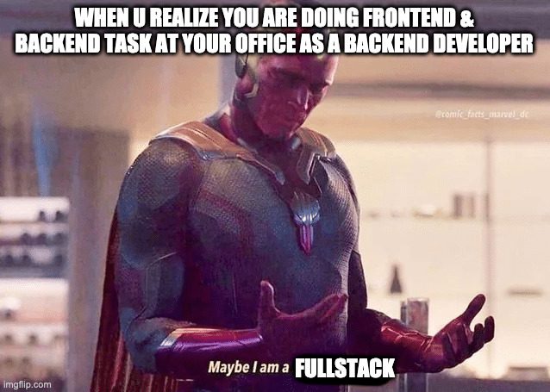
already know which role you have picked before ?

Slide 14
FullStack

Slide 15
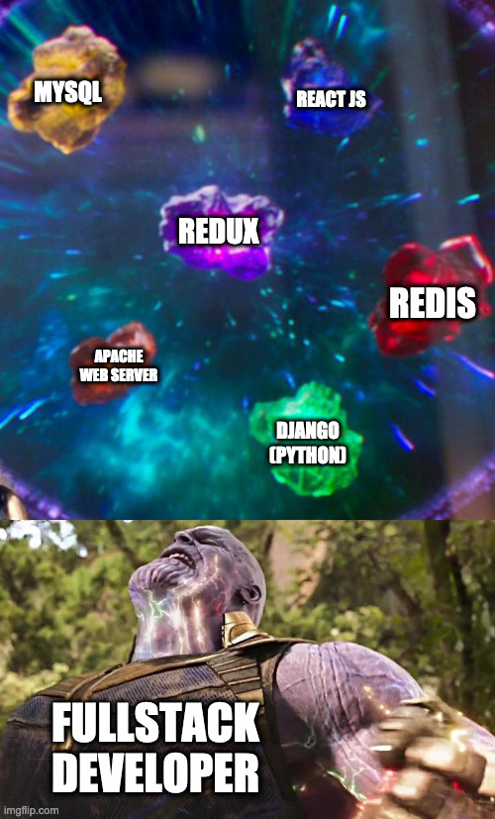
Fullstack is him

Slide 16
Conclusion

Slide 17
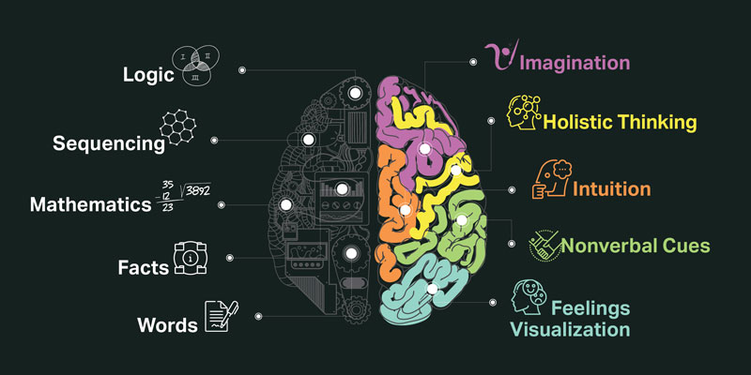

Slide 18
Final Words

Slide 19
“Semua Akan FullStack Pada Waktunya”
-Engineer Serabutan

Slide 20

The Answer of the most Frequently Asked Questions

Slide 21
Slide References
https://www.bitdegree.org/tutorials/what-is-a-web-developer/
https://www.youtube.com/watch?v=pkdgVYehiTE
https://roadmap.sh/

Slide 22




Thanks for your attention
Feel free to ask me
Github.com/aldamr01
Linkedin.com/aldionamirrul
@Squidward_Tenpoles

